Slide 1
Gene Mutation

Slide 2
Mutation = change(s) in the nucleotide/base sequence of DNA; may occur due to errors in DNA replication or due to the impacts of chemicals or radiation to the DNA molecule
Mutation may result in coding sequences for new amino acids in proteins or not!
Mutations can occur due to errors during DNA replication (replication-dependent mutations)
Mutations can also occur independently of DNA replication (replication-independent mutations)
Mutagens, such as UV rays and chemicals, can cause mutations
May occur in somatic or germ-line cells:
  Somatic mutations are not inherited and thus play no major role in evolution
  In cases of antibody formation and malignant transformation, somatic mutations are significant
  Only germ-line mutations are inherited and thus are important in evolution

Slide 3
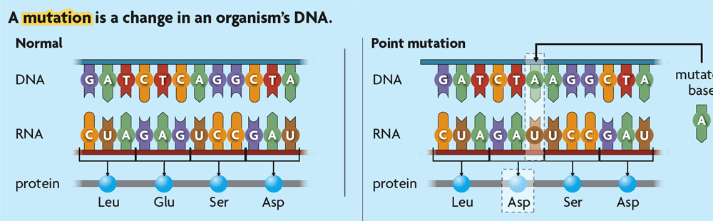
Mutations on the basis of the molecular nature of the defect:
  A: Base substitution
mutated
base

Slide 4
A base substitution usually leads to base pair substitution
GGG AGT GTA GAT CGT
CCC TCA CAT CTA GCA
GGG AGT GCA GAT CGT
A base substitution
CCC TCA CAT CTA GCA
First cycle of DNA replication
GGG AGT GCA GAT CGT
CCC TCA CAT CTA GCA
CCC TCA CGT CTA GCA
GGG AGT GTA GAT CGT

Slide 5
Base substitution is of two types:
Transition:
Purine is replaced with a purine
Pyrimidine is replaced with a pyrimidine
A
G
G
A
C
T
T
C

Slide 6
Transversions:
A purine is replaced by a pyrimidine
A
C
A
T
G
C
G
T
or a pyrimidine is replaced by a purine
C
G
C
A
T
G
T
A

Slide 7
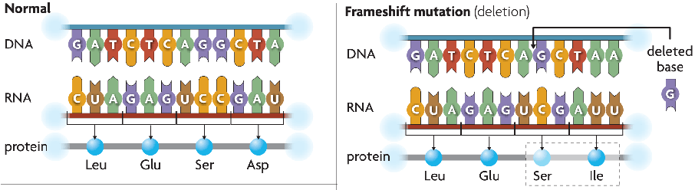
  Insertions & deletions

Slide 8
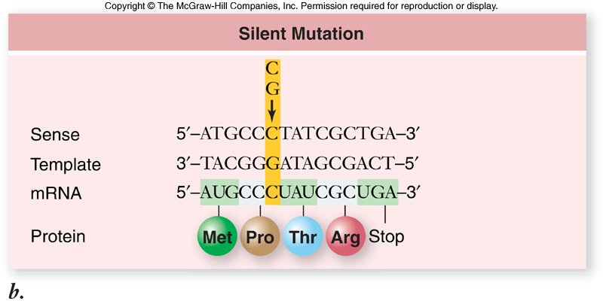
Silent mutation
Due to redundancy of Genetic Code, no change in amino acid sequence is produced!!

Slide 9
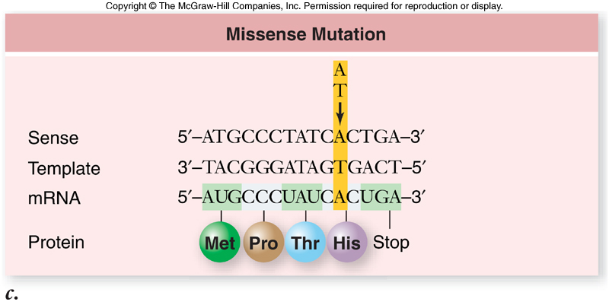
Missense mutation
Missense mutation produces a change in amino acid sequence in protein product (Histidine in for Arginine); may change function of protein or may not!

Slide 10
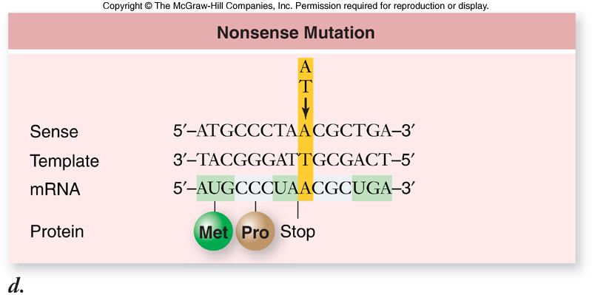
Nonsense mutation
Bad news! – nonsense mutation produces a STOP codon within the mRNA transcript leading to a truncated protein. How short the protein product depends on where the STOP codon was produced within the mRNA transcript.

Slide 11
Thank You

